Slide 1
MISTA: A Taint Analysis Framework for Microservices
Akira Tong
July 2023
1

Slide 2
Paper Timeline
Current Progress:
Successfully built and configured FlowDroid to take in a .jar file
Successfully built, but still need to work on configuring Jasmine to take in .jars and store output in a specified directory
Successfully built and configured InterSoot to take in original PiggyMetrics .jar files, need to debug InterSoot for taking in modified PiggyMetrics and other .jar files
Found 2 real-world cases of injection vulnerabilities for Java Spring microservices
Injected 2 data leakage vulnerabilities into PiggyMetrics services
Notes:
Currently found: CVE-2022-24815, CVE-2021-37694, CVE-2023-31444, CVE-2022-39388, CVE-2022-39271, CVE-2022-31053, CVE-2022-31045, CVE-2022-28660, CVE-2022-24726, CVE-2022-23635, CVE-2022-21701, CVE-2022-21679, CVE-2022-20762, CVE-2021-39156, CVE-2021-39155, CVE-2021-32753 via the CVE List keyword search. They were all from the search “microservice” + “injection”.

Slide 3
Paper Timeline
Target deadline: ISSTA, Dec 15, 2023
Problem statement: Vulnerability detection in microservices
Justification: microservices are prevalent (citation needed) + vulnerabilities in microservices are prevalent and can cause damage (monetary + reputation) (examples from real-world cases, or citations) (Jun 30th)
Current work + gap: what relevant work can do + cannot do (with motivating example) (Jul 21st)
Criteria for motivating example:
Show what is wrong with current work
Everything great with MISTA ☺
Our contribution: MISTA (highlight scientific idea + novelties, show how gap is filled, insight) (Jul 21st)
Not tool paper (no details in implementation)
Evaluation: (Jul 21st)
External evaluation: solve the problem statement (solve examples given in justification)
Comparison w/ baseline: compare with the related work
Internal evaluation: novelties and improvements with our tool (showcase our idea)
Methodology (case studies, metrics) (Jul 21st)
Notes:
Currently found: CVE-2022-24815, CVE-2021-37694, CVE-2023-31444, CVE-2022-39388, CVE-2022-39271, CVE-2022-31053, CVE-2022-31045, CVE-2022-28660, CVE-2022-24726, CVE-2022-23635, CVE-2022-21701, CVE-2022-21679, CVE-2022-20762, CVE-2021-39156, CVE-2021-39155, CVE-2021-32753 via the CVE List keyword search. They were all from the search “microservice” + “injection”.

Slide 4
Paper Timeline
July 21st
Aug 15th
Oct 15th
Nov 5th
Dec 15th
Nov 15th
Sep 5th
Sep 15th
Tools stitched together and working
Results, tables, evaluation finished
Introduction finished
ISSTA deadline
Proposal finished (everything on the previous slide)
Experiments conducted w/ usable results
Contribution and methodology finished
Paper final draft
Notes:
Currently found: CVE-2022-24815, CVE-2021-37694, CVE-2023-31444, CVE-2022-39388, CVE-2022-39271, CVE-2022-31053, CVE-2022-31045, CVE-2022-28660, CVE-2022-24726, CVE-2022-23635, CVE-2022-21701, CVE-2022-21679, CVE-2022-20762, CVE-2021-39156, CVE-2021-39155, CVE-2021-32753 via the CVE List keyword search. They were all from the search “microservice” + “injection”.

Slide 5

Security vulnerabilities
Can cause reputation and monetary loss
5. Evaluation
4.Our Contribution
3. The Gap
2. Current Work
1. Problem Statement
Notes:
Our project is about detecting security vulnerabilities for microservice-based applications. Such vulnerabilities can be very expensive for organizations and cause reputation and monetary losses.

Slide 6
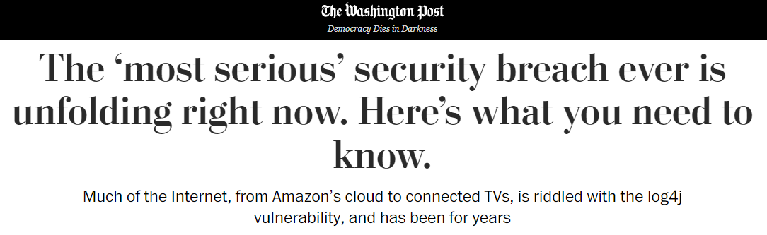

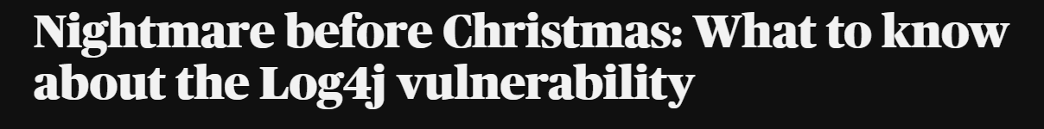
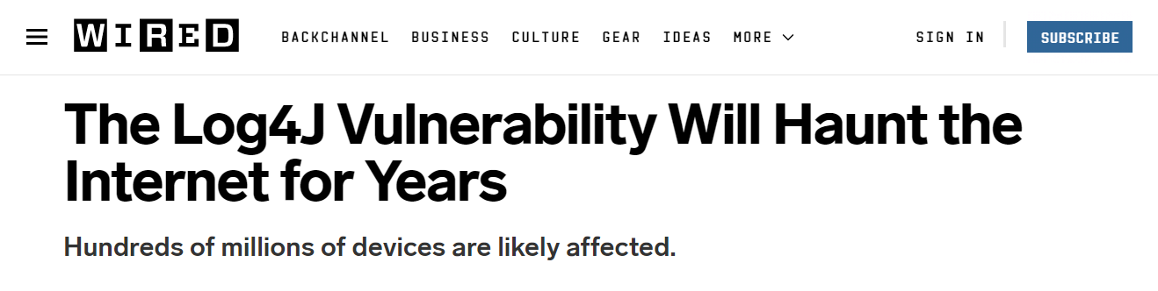
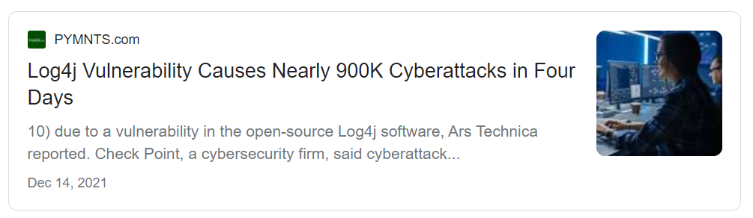
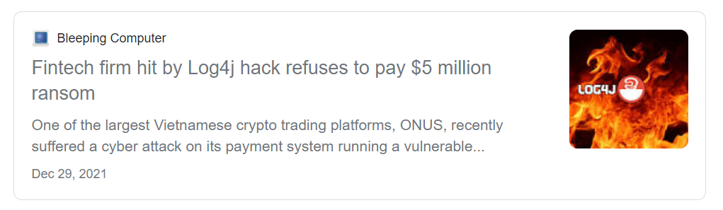
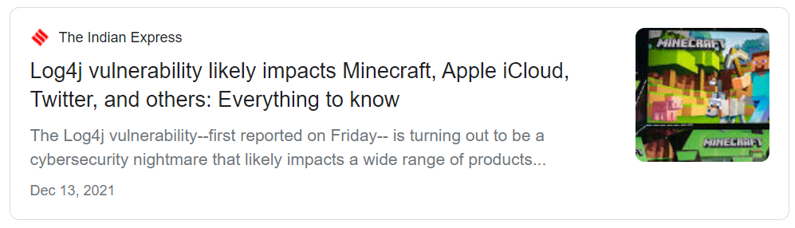

Security vulnerabilities
Can cause reputation and monetary loss
Example: Log4J vulnerability in December 2021 led to remote code execution
5. Evaluation
4.Our Contribution
3. The Gap
2. Current Work
1. Problem Statement
Notes:
For example, the Log4j vulnerability identified last December was, and still is, all over the news. To briefly summarize, Log4j is a popular logging library for Java applications, and it turns out that versions from 2.2.0-beta9 till 2.15.0 of the library contained a vulnerability that could be exploited to cause remote code execution.
It is reported that the Log4j vulnerability has caused nearly 900k cyberattacks in just four days and impacted numerous popular services including Apple iCloud, Twitter, and Minecraft.
In fact, recent reports show that around 30% of applications that use log4j library are still using a vulnerable version and it is predicted that the vulnerability will have a long-lasting impact.

Slide 7
Security vulnerabilities
Can cause reputation and monetary loss
Example: Log4J vulnerability in December 2021 led to remote code execution
5. Evaluation
4.Our Contribution
3. The Gap
2. Current Work
1. Problem Statement
Can be detected with Code Analysis
Notes:
This and similar security vulnerabilities can be detected with Code Analyses techniques, which is what we aim to work on in this project.

Slide 8
Microservices
A composition of small, loosely coupled components
Encapsulate individual business capabilities
Communicate using language-agnostic APIs
Internet
S2
5. Evaluation
4.Our Contribution
3. The Gap
2. Current Work
1. Problem Statement
S1
Internet
Internet
S3
Notes:
Our project is about detecting security vulnerabilities for microservice-based applications. Such vulnerabilities can be very expensive for organizations and cause reputation and monetary losses.

Slide 9
Why Microservices?
Clear boundaries among components
Easier to understand codebase
Independent deployment
Easier scaling up
Improved fault tolerance
Internet
S2
5. Evaluation
4.Our Contribution
3. The Gap
2. Current Work
1. Problem Statement
S1
Internet
Internet
S3
Notes:
Our project is about detecting security vulnerabilities for microservice-based applications. Such vulnerabilities can be very expensive for organizations and cause reputation and monetary losses.

Slide 10







Microservices are Popular
81.5% of respondent companies (N=950) already use microservices in 2021 [*]:
“17.5% of businesses plan to switch to the [microservices] architecture type”
“Only 1% of respondents are satisfied with the monolithic architecture”
84% of businesses (N=397) will keep investing in microservices development [**]:
5. Evaluation
4.Our Contribution
3. The Gap
2. Current Work
1. Problem Statement
“92% of businesses experienced zero issues when switching to the microservices architecture”
“26% of microservices adopters noticed security improvements”
[*] Survey by Statistica: https://www.statista.com/statistics/1236823/microservices-usage-per-organization-size/
[**] Survey by IBM: https://www.ibm.com/downloads/cas/OQG4AJAM
Notes:
Our project is about detecting security vulnerabilities for microservice-based applications. Such vulnerabilities can be very expensive for organizations and cause reputation and monetary losses.

Slide 11
Microservices are Popular
81.5% of respondent companies (N=950) already use microservices in 2021 [*]:
“17.5% of businesses plan to switch to the [microservices] architecture type”
“Only 1% of respondents are satisfied with the monolithic architecture”
84% of businesses (N=397) will keep investing in microservices development [**]:
5. Evaluation
4.Our Contribution
3. The Gap
2. Current Work
1. Problem Statement
“92% of businesses experienced zero issues when switching to the microservices architecture”
“26% of microservices adopters noticed security improvements”
Microservices are also prone to security vulnerabilities
[*] Survey by Statistica: https://www.statista.com/statistics/1236823/microservices-usage-per-organization-size/
[**] Survey by IBM: https://www.ibm.com/downloads/cas/OQG4AJAM
Notes:
Our project is about detecting security vulnerabilities for microservice-based applications. Such vulnerabilities can be very expensive for organizations and cause reputation and monetary losses.

Slide 12
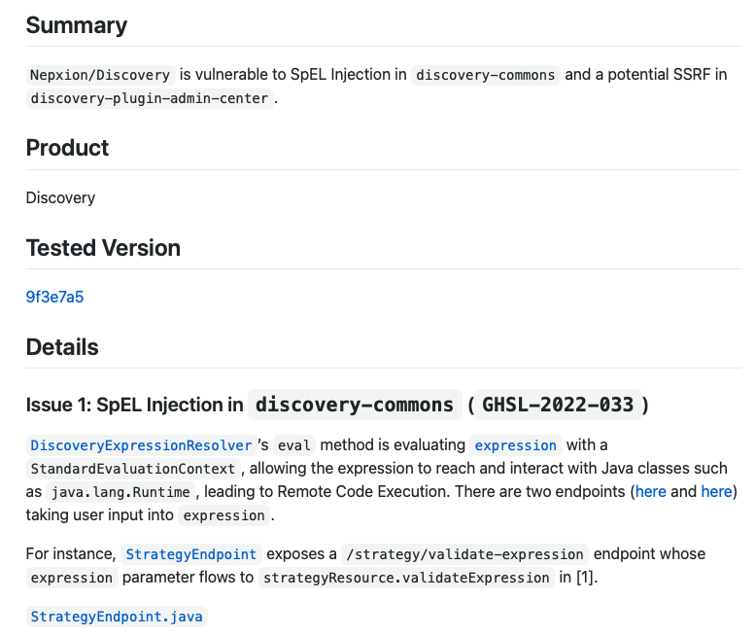
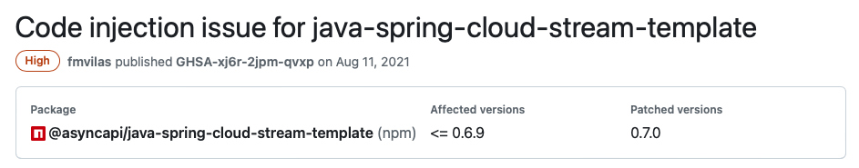
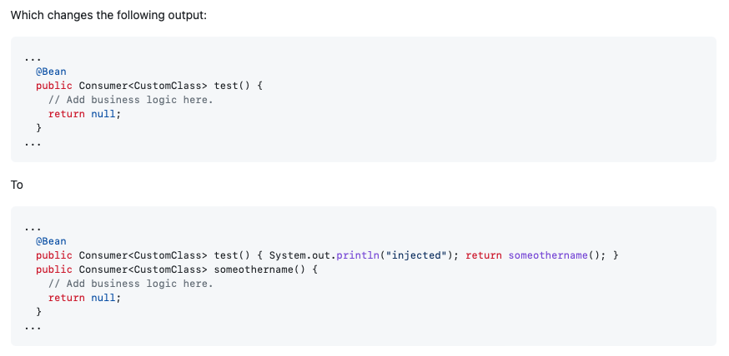
Vulnerabilities in Microservices
Microservices are also prone to security vulnerabilities
5. Evaluation
4.Our Contribution
3. The Gap
2. Current Work
1. Problem Statement
Notes:
Our project is about detecting security vulnerabilities for microservice-based applications. Such vulnerabilities can be very expensive for organizations and cause reputation and monetary losses.

Slide 13

Static Analysis for Monolith Applications
Alerts!
(null dereference, data leakage, SQL Injections, …)
Soot IR
Generator
IR
(Jimple)
Analysis
Application
to analyze
Control flow graph/
Data flow graph
5. Evaluation
4.Our Contribution
3. The Gap
2. Current Work
1. Problem Statement
FlowDroid
Framework for conducting static analysis for monolith Android & Java applications
Accepts a single .jar file as input, outputs console print
Notes:
Our project is about detecting security vulnerabilities for microservice-based applications. Such vulnerabilities can be very expensive for organizations and cause reputation and monetary losses.

Slide 14


Taint Analysis
Sources
Sinks
5. Evaluation
4.Our Contribution
3. The Gap
2. Current Work
1. Problem Statement
Notes:
Our project is about detecting security vulnerabilities for microservice-based applications. Such vulnerabilities can be very expensive for organizations and cause reputation and monetary losses.

Slide 15
Taint Analysis
Sources
Sinks
5. Evaluation
4.Our Contribution
3. The Gap
2. Current Work
1. Problem Statement
User input, e.g.,
User.setPassword
(password)
Logger output:
Log.info
(password)
Leakage path found
Found potential vulnerability!
User input in User.setPassword(password) → Log.info(password)
Notes:
Our project is about detecting security vulnerabilities for microservice-based applications. Such vulnerabilities can be very expensive for organizations and cause reputation and monetary losses.

Slide 16




Frameworks for building Microservices
5. Evaluation
4.Our Contribution
3. The Gap
2. Current Work
1. Problem Statement
26.9k repositories: “Spring Microservice”
129 repositories : “Dropwizard Microservice”
238 repositories : “Micronaut Microservice”
387 repositories: “Quarkus Microservice”
Notes:
Our project is about detecting security vulnerabilities for microservice-based applications. Such vulnerabilities can be very expensive for organizations and cause reputation and monetary losses.

Slide 17
Spring
Spring’s capabilities enable developers to build microservices more easily, and is therefore the most popular framework
Lightweight and modular framework suitable for developing and deploying microservices
Extensive support for building RESTful APIs (inter-service communication)
Integration with other technologies (Apache Kafka, MySQL, AWS, etc.)
Usage of technologies to make it easier to write clean and maintainable code
5. Evaluation
4.Our Contribution
3. The Gap
2. Current Work
1. Problem Statement
Notes:
Our project is about detecting security vulnerabilities for microservice-based applications. Such vulnerabilities can be very expensive for organizations and cause reputation and monetary losses.

Slide 18
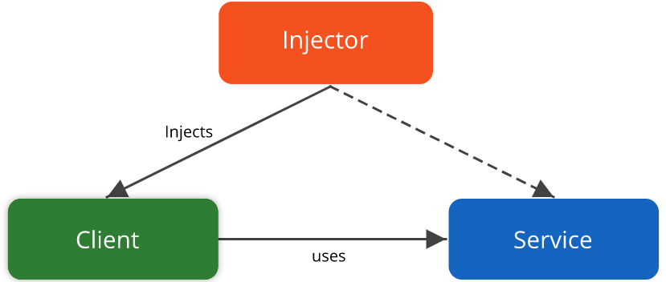
Dependency Injection
Improves the reusability of code through decoupling (reducing interdependence between components)
An object’s instance variables are injected by dependency injectors at runtime rather than created
Frameworks like Spring
Users through constructors and setter methods
Problematic for static analysis because we will not be able to determine certain instance variables until runtime
Notes:
Dependency Injection:
Dependencies are passed in at runtime, rather than hard-coded into objects
Difficult for static analysis to capture due to complex and dynamic control flows
Aspect-Oriented Programming:
Modifies the program’s behaviour through annotations and dynamic proxies
Behaviour may depend on values calculated at runtime

Slide 19
Dependency Injection
public class One() {
Two x;
// inject through constructor
One(Two dep) {
this.x = dep;
}
// inject through setter method
public void setTwo(Two dep) {
this.x = dep;
}
}
x is an instance variable of type Two
We can pass a Two variable dep into the constructor, thereby injecting the dependency into class One
We can also pass a variable into the setter method to achieve the same result
Notes:
Dependency Injection:
Dependencies are passed in at runtime, rather than hard-coded into objects
Difficult for static analysis to capture due to complex and dynamic control flows
Aspect-Oriented Programming:
Modifies the program’s behaviour through annotations and dynamic proxies
Behaviour may depend on values calculated at runtime

Slide 20
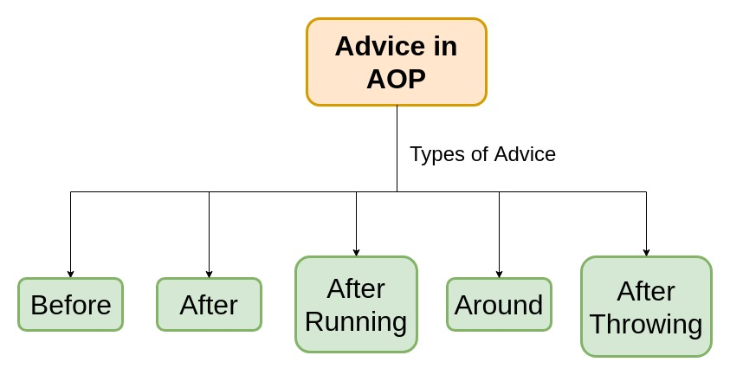
Aspect-Oriented Programming
Separates non-core functionality (eg. logging, authentication) from the application's core functionalities
Advices: code snippets ran at a specific point in the code
Aspects: reusable pieces of code containing several advices
AOP allows aspects to be applied to multiple methods in the application
Problematic for static analysis because we will not be able to determine certain aspect behaviors until runtime
Notes:
Dependency Injection:
Dependencies are passed in at runtime, rather than hard-coded into objects
Difficult for static analysis to capture due to complex and dynamic control flows
Aspect-Oriented Programming:
Modifies the program’s behaviour through annotations and dynamic proxies
Behaviour may depend on values calculated at runtime

Slide 21
Aspect-Oriented Programming
public aspect LoggingAspect {
pointcut loggableMethods(): execution (* com.example.myapp.*.*(..));
before(): loggableMethods() {
System.out.println(“Method is about to be invoked…”);
}
after(): loggableMethods() { System.out.println(“Method invocation completed.”);
}
}
This specifies that all methods in the package com.example.myapp and sub-packages will be subject to the aspects
The pointcut declaration defines join points, which are the methods where the aspect will be applied
The before() advice is executed before each relevant method
The after() advice is executed after each relevant method
Notes:
Dependency Injection:
Dependencies are passed in at runtime, rather than hard-coded into objects
Difficult for static analysis to capture due to complex and dynamic control flows
Aspect-Oriented Programming:
Modifies the program’s behaviour through annotations and dynamic proxies
Behaviour may depend on values calculated at runtime

Slide 22
Modelling for Java Spring Applications
Soot IR
Generator
IR
(Jimple)
DI/AOP analysis
Application
to analyze
Control flow graph/
Data flow graph
Modelled
application
5. Evaluation
4.Our Contribution
3. The Gap
2. Current Work
1. Problem Statement
Jasmine
Framework for modelling dynamic Spring features (dependency injection, aspect-oriented programming)
Accepts a single .jar file as input, produces a .jar file with statically modelled features
The output .jar file is ready to be fed into FlowDroid to detect vulnerabilities
Notes:
Our project is about detecting security vulnerabilities for microservice-based applications. Such vulnerabilities can be very expensive for organizations and cause reputation and monetary losses.

Slide 23
An Example with Microservices
S1
S2
1.public class S1{
2.
3. public void search(String input){
4. // send input to S2
5. ...
6. }
7.}
1.public class S2{
2.
3. public void foo(...){
4. // read input from request
5. logger.info(input); // Log4J2
6. ...
7. }
8.}
5. Evaluation
4.Our Contribution
3. The Gap
2. Current Work
1. Problem Statement
HTTP call
Source
Sink
Notes:
Our project is about detecting security vulnerabilities for microservice-based applications. Such vulnerabilities can be very expensive for organizations and cause reputation and monetary losses.

Slide 24
An Example with Microservices
S1
S2
1.public class S1{
2.
3. public void search(String input){
4. // send input to S2
5. ...
6. }
7.}
1.public class S2{
2.
3. public void foo(...){
4. // read input from request
5. logger.info(input); // Log4J2
6. ...
7. }
8.}
Current state-of-the-art tools don’t analyze these microservices holistically and miss inter-service leakage paths
5. Evaluation
4.Our Contribution
3. The Gap
2. Current Work
1. Problem Statement
HTTP call
Notes:
Our project is about detecting security vulnerabilities for microservice-based applications. Such vulnerabilities can be very expensive for organizations and cause reputation and monetary losses.

Slide 25
Addressing the Gap
3. The Gap
Therefore, there is no framework that allows end users to conduct vulnerability analysis on microservices
5. Evaluation
4.Our Contribution
3. The Gap
5. Evaluation
4.Our Contribution
2. Current Work
2. Current Work
1. Problem Statement
1. Problem Statement
Notes:
Our project is about detecting security vulnerabilities for microservice-based applications. Such vulnerabilities can be very expensive for organizations and cause reputation and monetary losses.

Slide 26
Static Analysis for Java Spring Microservices
S1
FlowDroid
S2
IR
(Jimple)
Analysis
Alerts!
(null dereference, data leakage, SQL Injections, …)
Soot IR
Generator
DI/AOP Modelling
5. Evaluation
4.Our Contribution
3. The Gap
2. Current Work
1. Problem Statement
S3
Microservices
to analyze
Inter/intraservice
Control flow graph/
Data flow graph
Jasmine
Notes:
Our project is about detecting security vulnerabilities for microservice-based applications. Such vulnerabilities can be very expensive for organizations and cause reputation and monetary losses.

Slide 27
Static Analysis for Java Spring Microservices
S1
FlowDroid
S2
IR
(Jimple)
Analysis
Alerts!
(null dereference, data leakage, SQL Injections, …)
Soot IR
Generator
DI/AOP Modelling
5. Evaluation
4.Our Contribution
3. The Gap
2. Current Work
1. Problem Statement
S3
Microservices
to analyze
Inter/intraservice
Control flow graph/
Data flow graph
Jasmine
Existing static analysis tools miss inter-service API calls (over the network)
Notes:
Our project is about detecting security vulnerabilities for microservice-based applications. Such vulnerabilities can be very expensive for organizations and cause reputation and monetary losses.

Slide 28
Our Goal
Build a static analysis infrastructure
that can combine existing state-of-the-art tools with our own framework modelling inter-service calls to perform vulnerability analysis on microservices
5. Evaluation
4.Our Contribution
3. The Gap
2. Current Work
1. Problem Statement
Notes:
Our project is about detecting security vulnerabilities for microservice-based applications. Such vulnerabilities can be very expensive for organizations and cause reputation and monetary losses.

Slide 29
Our Contributions
We make the following contributions:
Propose a novel approach to combine existing Spring modelling (i.e., Jasmine) and Java static analysis (i.e., FlowDroid), along with our own interservice modelling tool, to create an infrastructure for detecting vulnerabilities in microservices
Present a test suite containing manually-injected and open-source real-world vulnerable microservices to evaluate the performance of microservice vulnerability detection frameworks
5. Evaluation
4.Our Contribution
3. The Gap
2. Current Work
1. Problem Statement
Notes:
Ask more about this

Slide 30
Our Solution
S1
FlowDroid
S2
IR
(Jimple)
Analysis
Alerts!
(null dereference, data leakage, SQL Injections, …)
Soot IR
Generator
DI/AOP Modelling
5. Evaluation
4.Our Contribution
3. The Gap
2. Current Work
1. Problem Statement
S3
Microservices
to analyze
Inter/intraservice
Control flow graph/
Data flow graph
Jasmine
Inter-Service
Call Detector
Inter-Service
Call Modelling
Service
calls
Modified IR
(Jimple)
Notes:
Our project is about detecting security vulnerabilities for microservice-based applications. Such vulnerabilities can be very expensive for organizations and cause reputation and monetary losses.

Slide 31
Our Solution
We simplify inter-service calls into method calls by analyzing Spring configuration files, infrastructure services, and annotations to modify the IR (Jimple Files). The modified IR can then be fed into static analysis tools for vulnerability detection.
5. Evaluation
4.Our Contribution
3. The Gap
2. Current Work
1. Problem Statement
Notes:
Our project is about detecting security vulnerabilities for microservice-based applications. Such vulnerabilities can be very expensive for organizations and cause reputation and monetary losses.

Slide 32
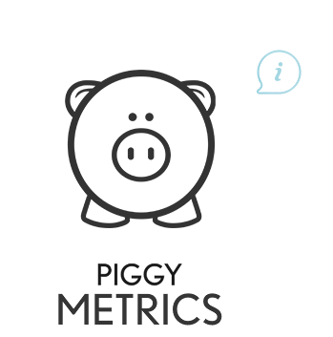

Benchmark Construction
We present a test-suite consisting of manually-injected vulnerabilities and open-source real-world vulnerable microservice applications
5. Evaluation
4.Our Contribution
3. The Gap
2. Current Work
1. Problem Statement
Notes:
Ask more about this

Slide 33
Manual Injections
Manually inject vulnerabilities into microservice applications
Easier to control the vulnerability type, acts as a supplement for real-world cases
Selected based on set criteria:
High number of inter-business service calls
High number of business microservices
High number of infrastructure microservices
Selected microservice: Piggymetrics
5. Evaluation
4.Our Contribution
3. The Gap
2. Current Work
1. Problem Statement
Notes:
Ask more about this

Slide 34
Manual Injections
Data leakage vulnerability
Sensitive information (username and password of the user & name of the account are being logged).
public Account create(User user) {
log.info(user.getUsername() + user.getPassword());
Account account = new Account();
account.setName(user.getUsername());
account.setLastSeen(new Date());
account.setSaving(saving);
repository.save(account);
log.info("account created: "+ account.getName());
}
5. Evaluation
4.Our Contribution
3. The Gap
2. Current Work
1. Problem Statement
Data leakage vulnerability
Absence of encryption or hashing when storing the password into the database makes the sensitive information vulnerable.
public void create(User user) {
//String hash = encoder.encode(user.getPassword());
String hash = user.getPassword();
user.setPassword(hash);
repository.save(user);
log.info("user created: {}", user.getUsername());
}

Slide 35
Real-World Vulnerable Applications
Real-world vulnerable applications are usually collected by scraping open-source security databases or by screening open-source applications with a tool
Common Vulnerabilities and Exposures Database (CVE)
Contains a collection of vulnerable applications classified by ID and vulnerability type, with a short summary of the issue
Selected the former approach because vulnerabilities are already classified and described with detail
5. Evaluation
4.Our Contribution
3. The Gap
2. Current Work
1. Problem Statement
Notes:
Ask more about this

Slide 36
Real-World Vulnerable Applications
Search CVE Database .csv for injection flaw and data leakage vulnerability reports on open-source microservice-based applications
Using keywords “Microservice” + (“Injection” | “Data leakage” | “vulnerable”) + “Spring” + "Java”
Filter out all non-Microservice applications or private repositories (no Github repo link)
Ensure the program is using Java 8 and Spring 5.3 as required by our tool
Find vulnerability-related commits, and restore to previously vulnerable version
5. Evaluation
4.Our Contribution
3. The Gap
2. Current Work
1. Problem Statement
Notes:
Ask more about this

Slide 37
Real-World Vulnerable Applications
CVE entries found through search: 12
Private entries (no Github link): 8
Non-microservice entries: 2
Satisfactory entries: 2
5. Evaluation
4.Our Contribution
3. The Gap
2. Current Work
1. Problem Statement
CVE ID | Name | Vulnerability Type | Github Stars | Github Contributors | Date of Last Commit | Reproducible?
CVE-2021-37694 | Java Spring Cloud Stream Generator Template | Injection Flaw | 32 | 20 | Apr. 27, 2023 | Y
CVE-2022-23463 | Nepxion Discovery | Injection Flaw | 5.3k | 11 | Apr. 9, 2023 | Y
Notes:
Ask more about this

Slide 38
Research Questions
We propose the following research questions:
How well does MISTA model the inter-service communications and Spring core technologies compared to current state-of-the-art frameworks (Jasmine ext. FlowDroid)?
What performance enhancements does MISTA bring to existing taint analysis tools (i.e., FlowDroid) when detecting vulnerabilities in microservices?
Can MISTA find vulnerabilities in real-world microservice-based applications?
5. Evaluation
4.Our Contribution
3. The Gap
2. Current Work
1. Problem Statement
Notes:
Need to ask Yingying

